Slide 1
https://codeburst.io/algorithms-i-searching-and-sorting-algorithms-56497dbaef20

Slide 2
CSS143 Computer Programming (II)

Slide 3
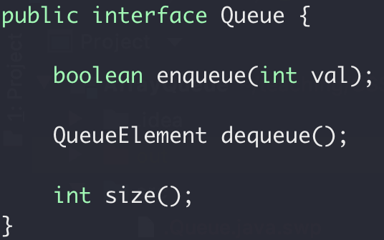
Abstract Data Type (ADT)
Interface
Public functions
Implementation
- Internal details (not exposed to outside)

Slide 4
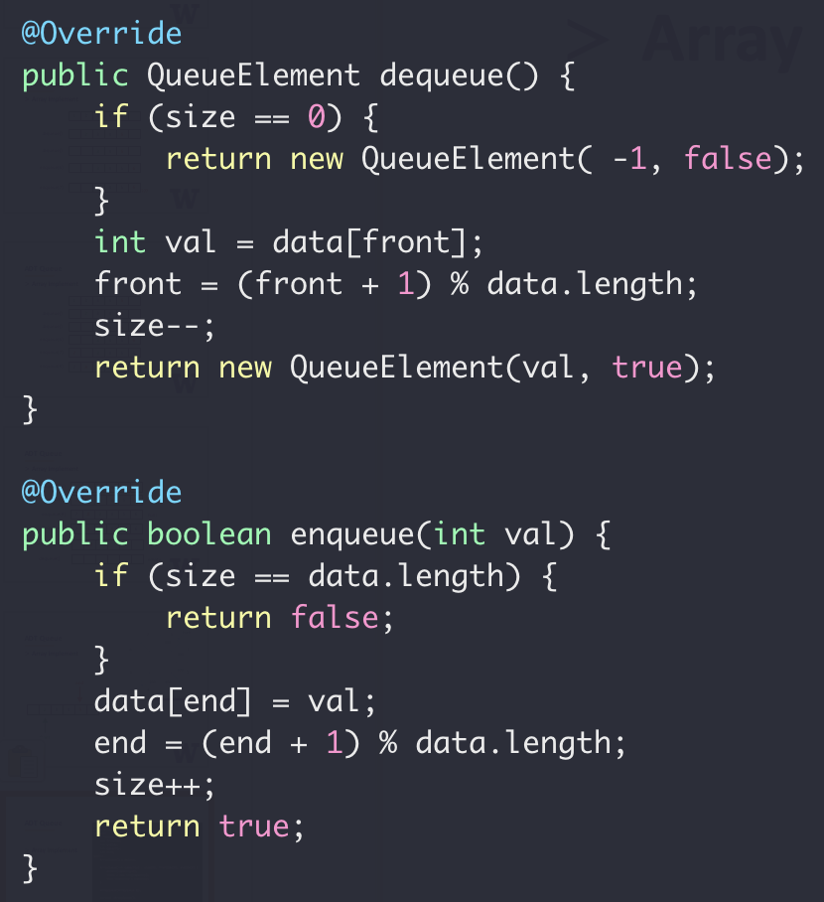
ADT Queue
Array Implement

Slide 5

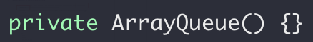
ADT Queue
disable default constructor

Slide 6
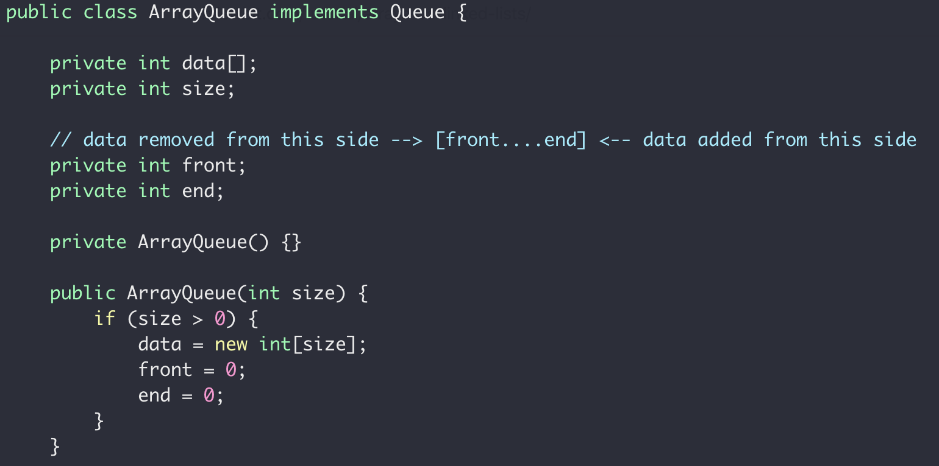
ADT Queue

Slide 7


Array vs List
12
12
1
7
18
10
3
0
1
2
3
4
5
6
Bookshelf

Slide 8
Array → List
12
12
1
7
18
10
3
head
12
12
12
1
7
18
10
3
value
“Node”
reference

Slide 9
Array vs List
0
12
1
8
2
3
4
7
0
5
10
1
12
6
head
2
12
0
7
3
12
1
8
4
1
4
9
5
7
18
10
6
18
11
14
7
10
12
3
8
3
13
null
9
14
10
10
15
12
array
list
16

Slide 10
Linked List Access

Slide 11
Array vs List
Array:
Contiguous in memory
Fast random access
Fixed size
12
12
1
7
18
10
3
head
12
12
1
7
18
10
3
null
LinkedList:
Random addressed in memory
No random access
Size not fixed

Slide 12
Linked List
“interface”
head
12
12
1
7
18
10
3
null
add(value) : Add a node in the end addFirst(value) : Add a node in the beginning
removeFirst() : Remove a node from the beginning removeLast() : Remove a node from the end
getFirst() : Return the first node getLast() : Return the last node
size() : Size of the list

